Slide 1
EMBEDDED SYSTEM

Slide 2

Automation

Slide 3
Embedded System
An embedded system is a microcontroller/microprocessor-based computer hardware system with software that is designed to perform a dedicated function, either as an independent system or as a part of a large system.
At the core is an integrated circuit designed to carry out computation for real-time operations.

Slide 4
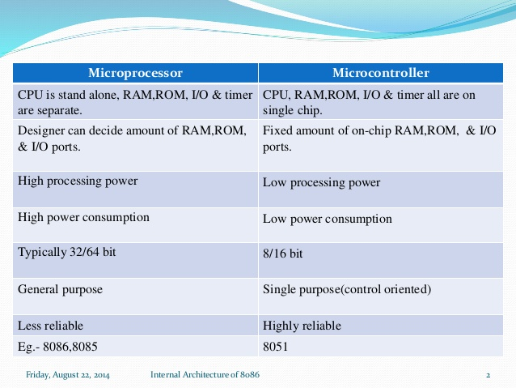
MICROPROCESSOR vs MICROCONTROLLER

Slide 5
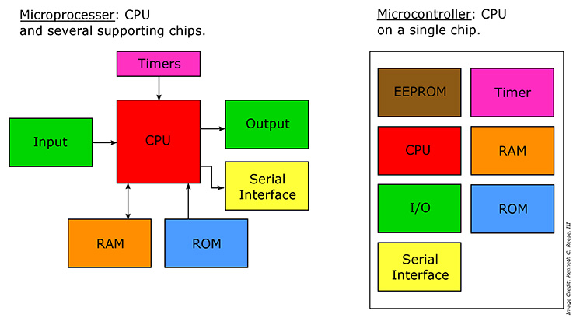
MICROPROCESSOR vs MICROCONTROLLER

Slide 6
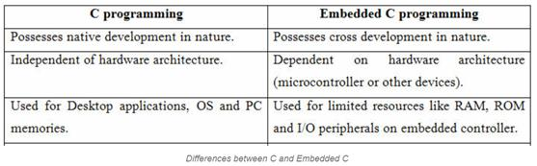
C vs Embedded C

Slide 7
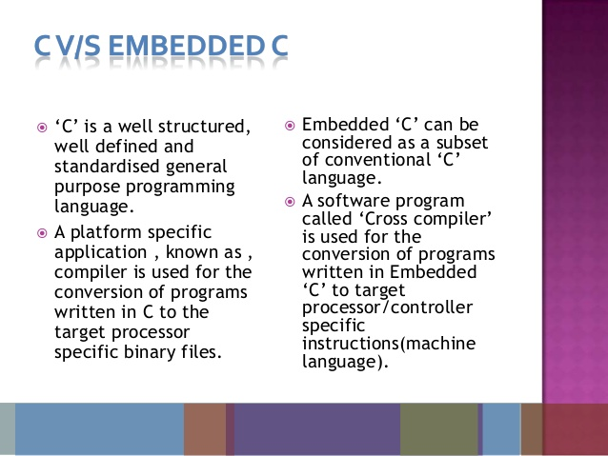
C vs Embedded C

Slide 8
COMPILER
Native Compiler
The compiler used to compiler a source code for same platform only.
Ex : Desktop applications,…
Cross Compiler
The compiler used to compiler a source code for dinfferent kind of platforms.
Ex : PIC controller, ARM controller.

Slide 9
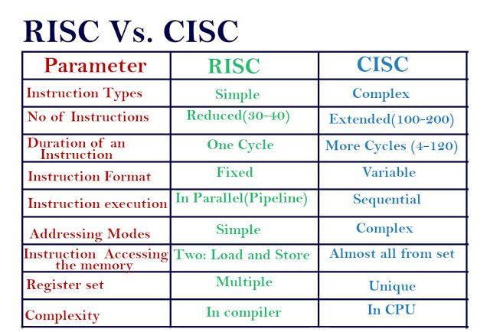
RISC vs CISC

Slide 10
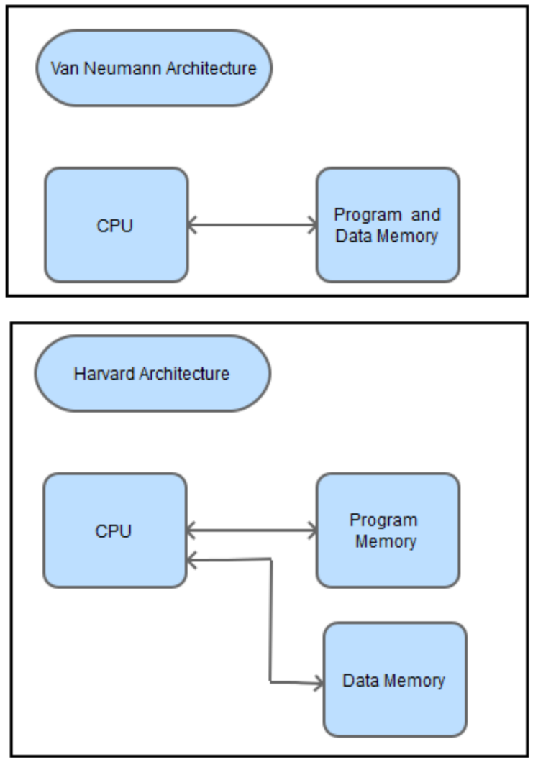
Von Neumann vs Harvard Architecture

Slide 11
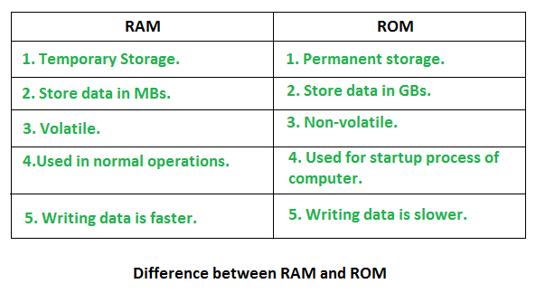
RAM and ROM

Slide 12
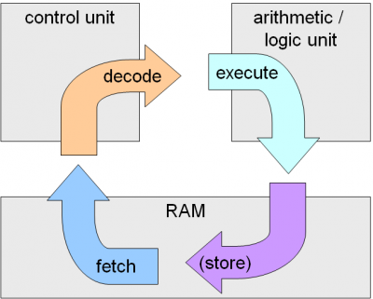
Instruction Cycle

Slide 13
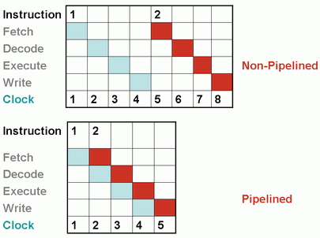
Pipelining

Slide 14
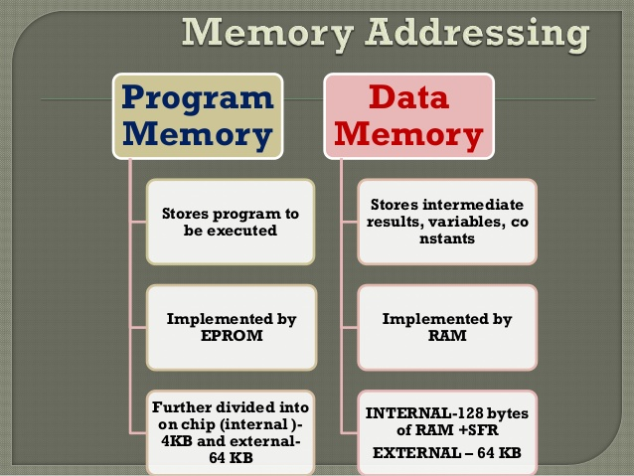
Program Memory vs Data Memory

Slide 15
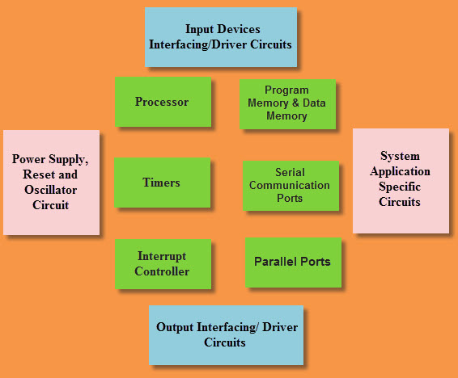
Parts of Embedded Systems

Slide 16
Embedded System Tools
MPLAB IDE
Proteus
PIC KIT 2 Programmer
Hi Tech C Compiler (Cross compiler)
Etc,…

Slide 17
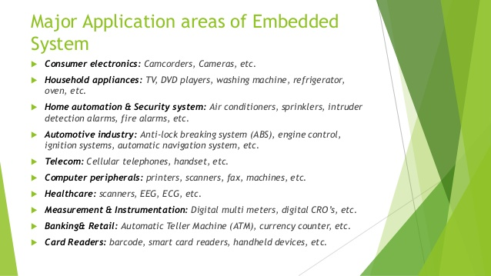
Applications of Embedded Systems

